Slide 1
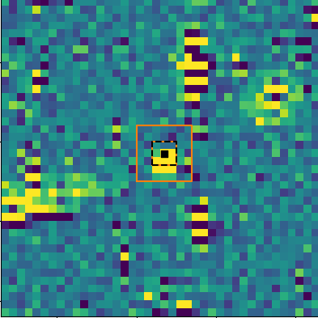
Asteroids in TESS
Brayden Leicester
Supervisors:
Michele Bannister and Ryan Ridden-Harper
Notes:
1

Slide 2
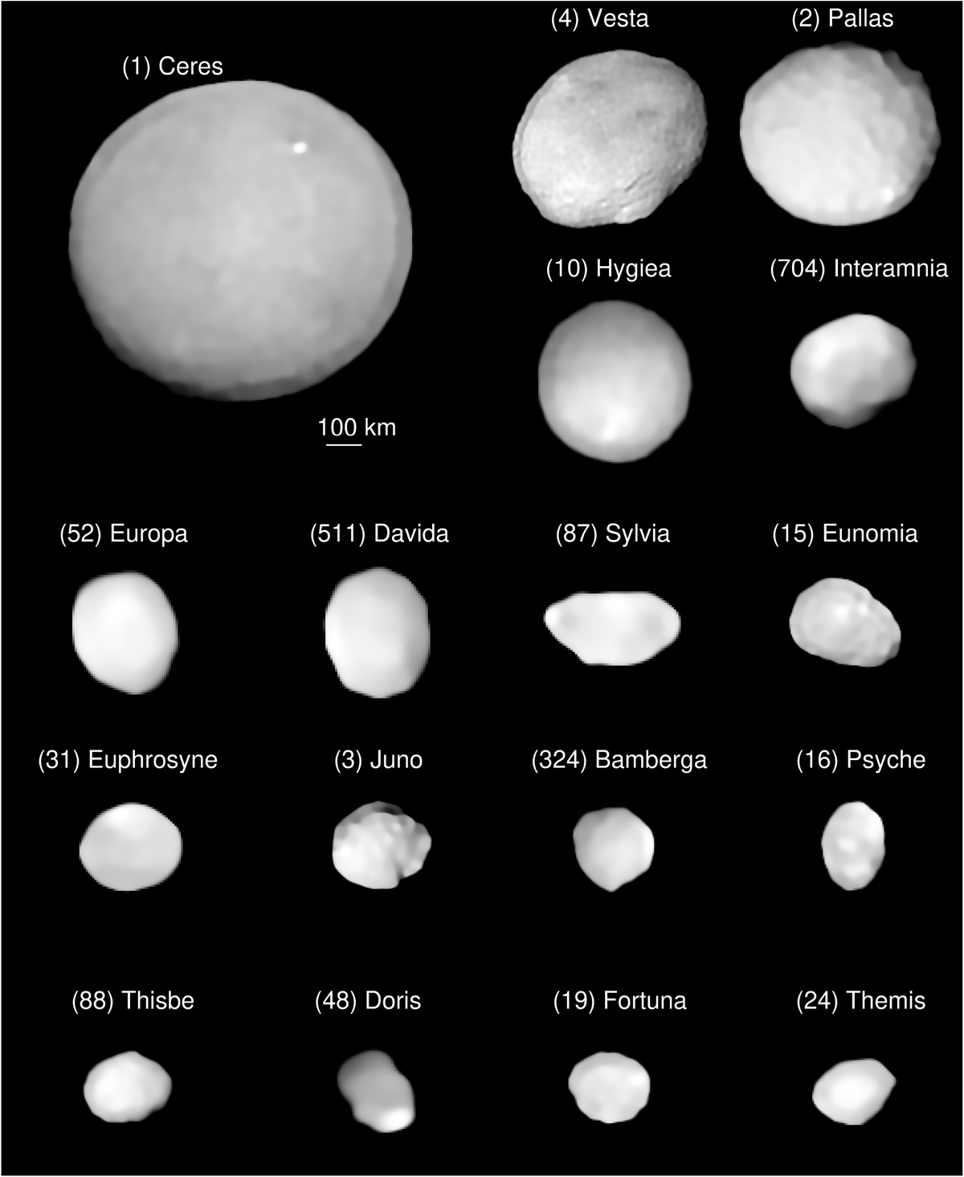
Asteroids
Rocky bodies in orbit of the sun
Distribution of rotation properties is of interest.
This work will focus on bright asteroids
VLT/Sphere images, Vernazza et al (2021)
Notes:
2

Slide 3
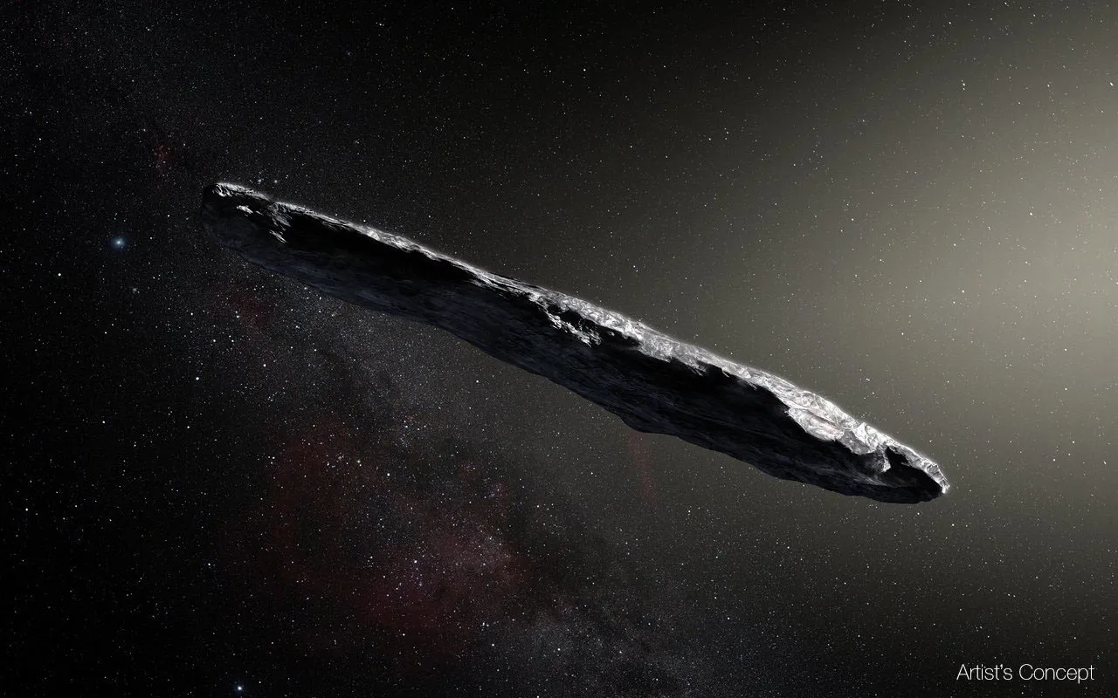
Interstellar Objects
Small bodies from made around other stars
Have seen 2 so far
‘Oumuamua was the first and asteroid like
Interesting rotation properties
NASA ‘Oumuamua Concept art:
https://science.nasa.gov/solar-system/comets/oumuamua/
Notes:
3

Slide 4
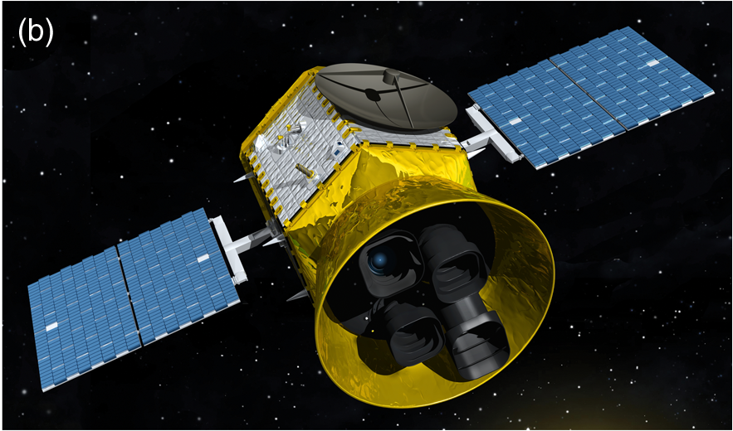
TESS
Huge FOV, 96°x24°
Fast Cadance, ≤30 min
But large pixels, 21” square
Built for exoplanets, but is an all-sky transient detector
Asteroids move at ~1px per frame
Fig.4.b. of Ricker et al. (2014)
Notes:
4

Slide 5
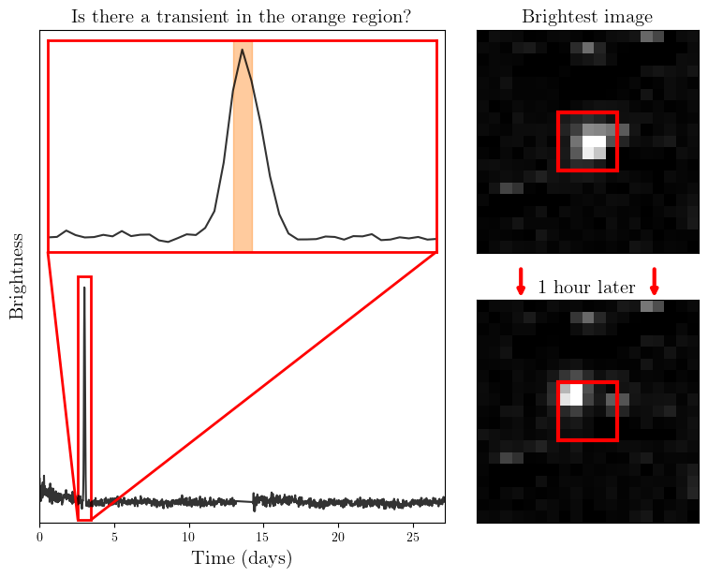
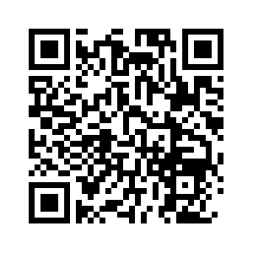
TESSELLATE
Pipeline to detect all transient events in TESS
These lights curves of a single pixel throughout the sector
This is an asteroid detection
There is a Zooniverse project to classify these events
Notes:
5

Slide 6
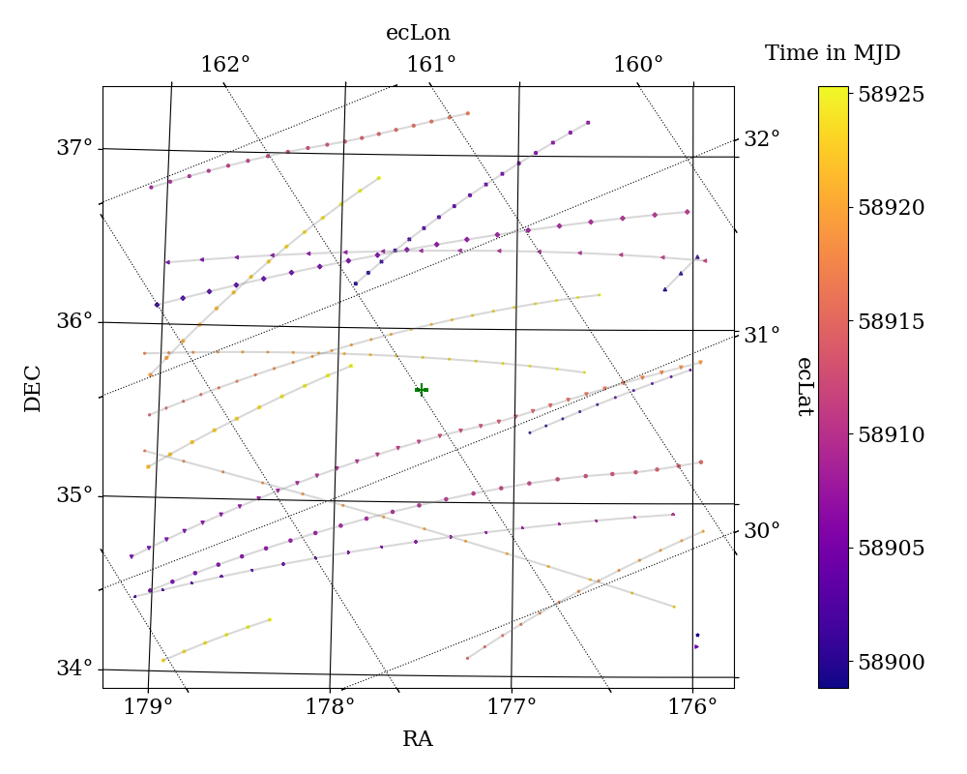
Querying Positions
Positions queried from ‘SkyBot’
Axes in RA/Dec and Ecliptic (ec) Longitude and Latitude
Notes:
6

Slide 7
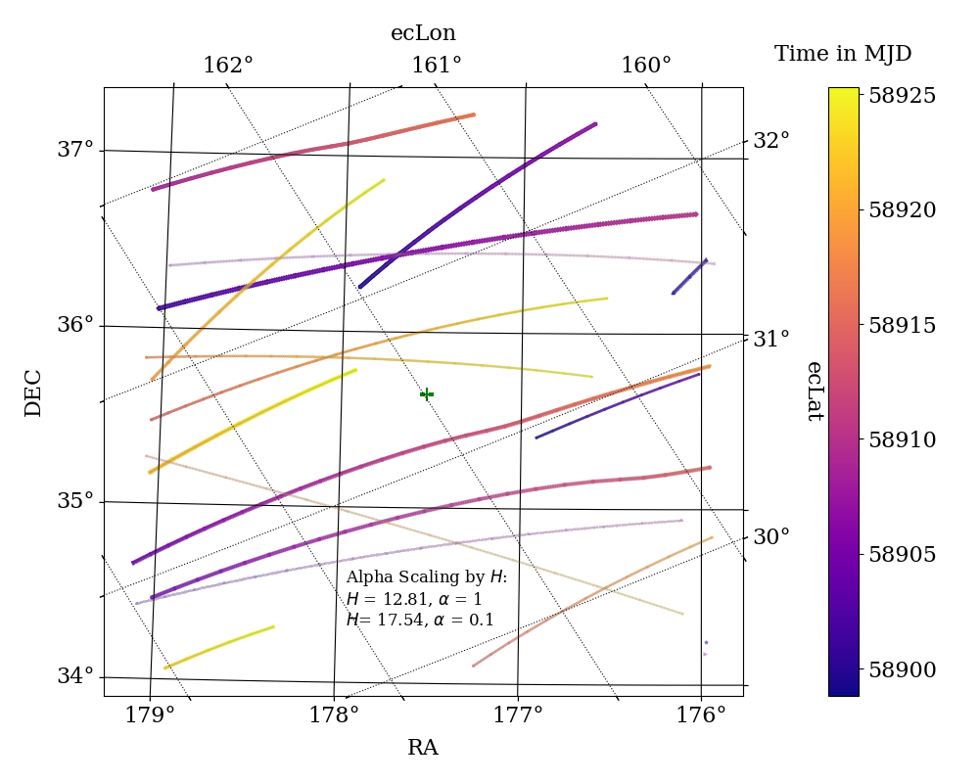
Interpolating
Interpolated to every 30 min
Same cadence as TESS
Allows the matching to be well sampled
Scaled by H, the absolute magnitude
Notes:
7

Slide 8
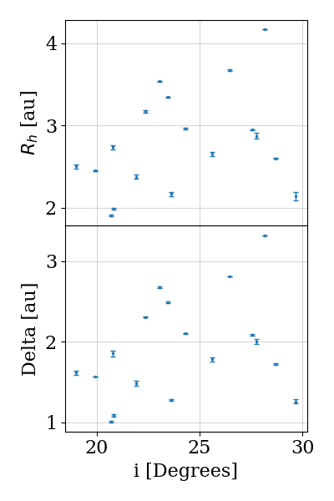
Other properties
Inclination of the asteroids vs:
Heliocentric distance
Distance from TESS
Queried from ‘JPL Horizons’
Notes:
8

Slide 9
Matching
Interpolations Detections
RA | Dec
RA | Dec
Use a KDTree to match interpolations to detections from TESSELLATE
Make cuts after matching by time and distance
Notes:
9

Slide 10
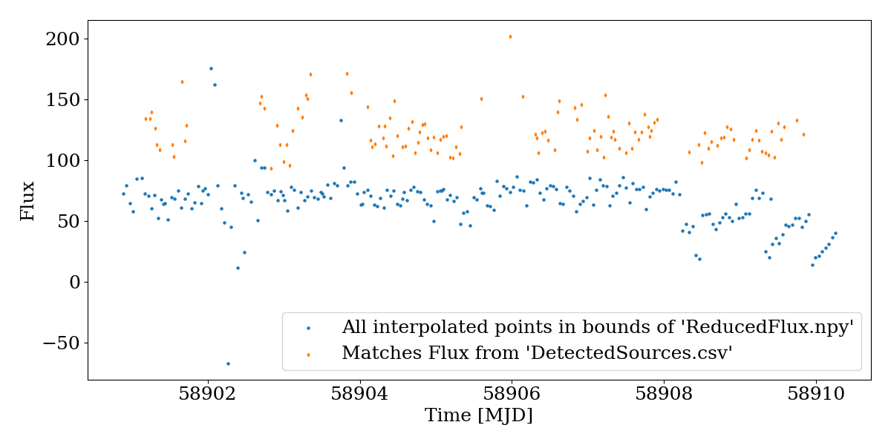
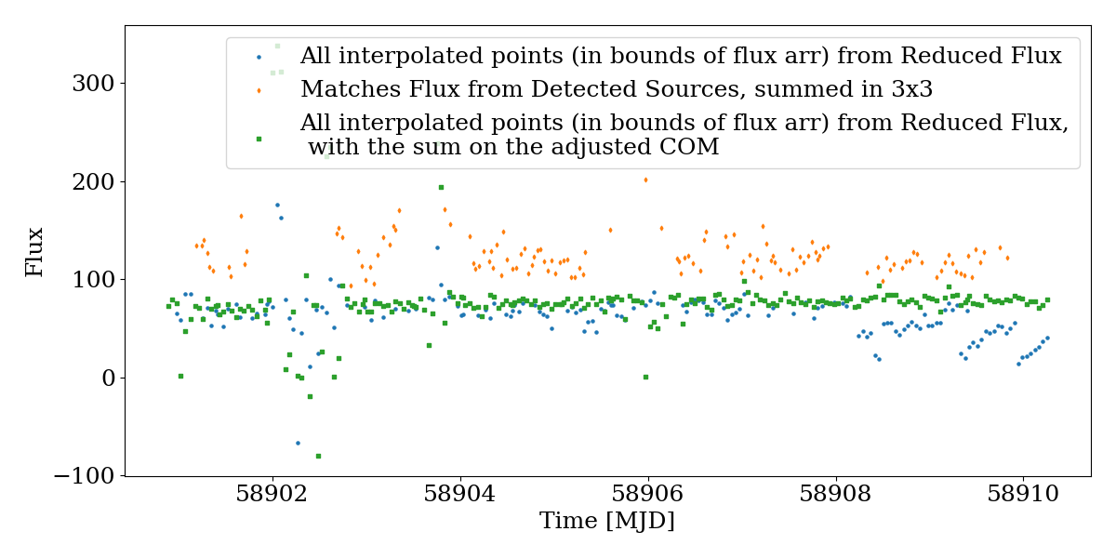
Light curves
Ruff
The light curves for the interpolated points and the detections are different.
Notes:
10

Slide 11
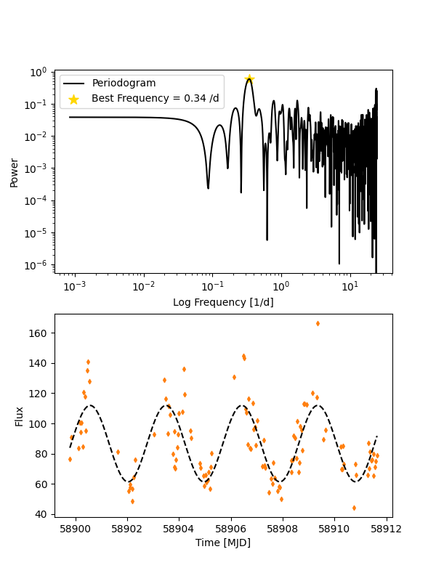
Period Detection
1999 JE82
Uses Lomb-Scargle Periodogram
Can use ‘Lightkurve’ package, or just ‘Astropy’ to compute these
Not fully thought through yet
Which set of points to use
Determining accuracy
Notes:
11

Slide 12
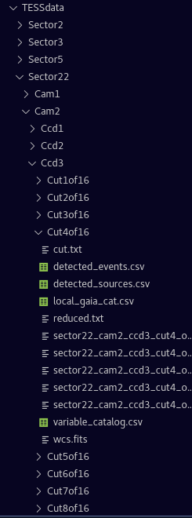
Scaling
Once everything works on one cut…
Scale to all sectors reduced with TESSELLATE
Get bulk statistics of asteroids.
Notes:
12

Slide 13
Summary
Trying to get properties of all asteroid in TESS
Have found and interpolated their positions.
Then matched these to detections
Need to characterise light curves properly and then scale up.
Notes:
13

Slide 14
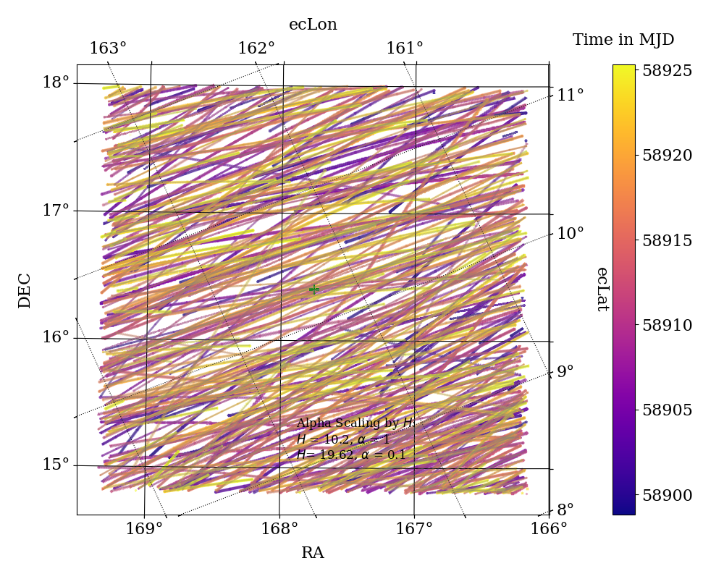
Extra Figures 1.
Notes:
14

Slide 15
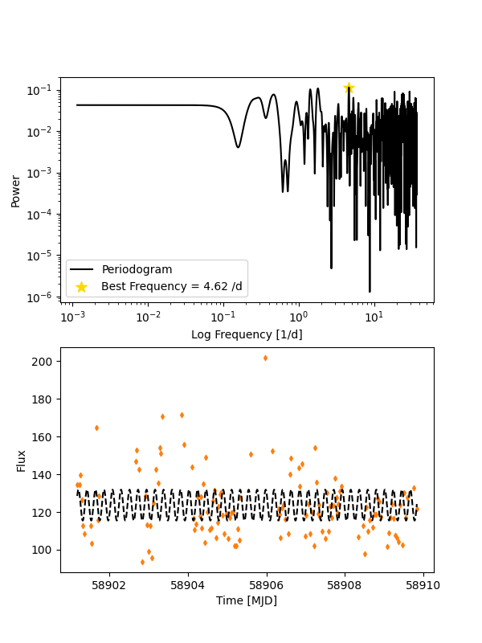
Extra Figures 2.
Notes:
15

